Slide 1

Application of AI in Data Security

Slide 2
Content
Brief Introduction
Advantages and Disadvantages of AI in data security
How Artificial intelligence works in data security
AI-Powered Data Security Solutions
Main Challenges of AI
Trending technologies of AI in security

Slide 3
Introduction
Information security occupies an important place in the modern world.
Everyone, wants to reduce the threat of theft, deletion, or alteration of their information.
According to an IDC study, "organizations will spend $ 101.6 billion by 2020 on cyber security software, services and hardware."
AI is a technology that, among other things, can detect threats and automatically take the necessary actions to eliminate and prevent them.

Slide 4
Advantages of AI in data security
AI learns more over time
Ai Identifies unknown treats
AI can handle a lot of data
Better vulnerability management
Fast detection and response time
Securing authentication … and a lot more.

Slide 5
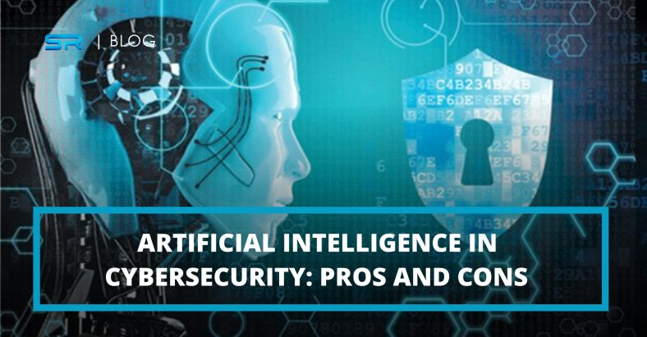
Disadvantages of AI in data security
Hackers use AI as well
Data confidentiality
Increasing need for data
High adoption barrier
A lot of time and money invested in resources

Slide 6
How Artificial intelligence works in data security?
AI works in cyber security by learning from past data to identify patterns and trends. This information is then used to make predictions about future attacks.
AI powered systems can also be configured to automatically respond to threats and fight cyber threats in quicker timescales and faster than the human cyber security engineers.

Slide 7
AI-Powered Data Security Solutions
Security Information and Event Management
a security tool that uses rules and statistical correlations to actionable information on security and helps security teams deal with events across the entire organizational environment. With the information provided by SIEM, SOC staffs are more equipped to deal with data security threats in real-time.

Slide 8
Cont’d
User and Entity Behavior Analytics
uses AI to collect, track and analyze data from computer activities to indicate suspicious behaviors. It learns patterns of legitimate access usage and uses these patterns to detect complex attacks like insider threats by recognizing behaviors that indicate malicious intent and jeopardize valuable data.

Slide 9
Cont’d
Security, Orchestration, Automation, and Response
a cyber-security solution used by organizations for data collection and alerts on threats.
It can detect threats and automatically deal with low-level threats quickly and efficiently.

Slide 10
Main Challenges of Implementing AI in data security
Not withstanding all the indisputable benefits AI brings to the cyber security industry, it should in no way be considered a complete solution.
AI isn’t necessarily the all-powerful solution to end cyber attacks all together. In fact, it poses challenges, too.

Slide 11

Cont’d
Some tasks performed by Ai can be manipulated if hackers manage to access them.
For example, an AI-enabled program could be tricked into labeling malicious software or dangerous user behavior as safe or normal, or the other way around.

Slide 12
Cont’d
Biometric authentication, which is highly popular among users, can also prove to be dangerous.
Biometric information in the wrong hands can be used for surveillance or other infringements of users’ privacy.
And unlike passwords, there is no way you can make any changes to your biometric data. This brings users to another problem.

Slide 13
Cont’d
Another challenge that AI poses is how expensive it actually is to implement.
Since a good deal of AI is still in its early stage of its development and is experimental, the cost associated with it may be too high for many businesses.

Slide 14
Cont’d
Criminals tapping into the power of AI solutions is also another major challenge to implement AI in data security.
Like network monitoring and learning patterns of user behavior, criminals can also apply machine learning to determine why certain cyber attacks have ended in failure and devise more powerful and effective attack models.

Slide 15
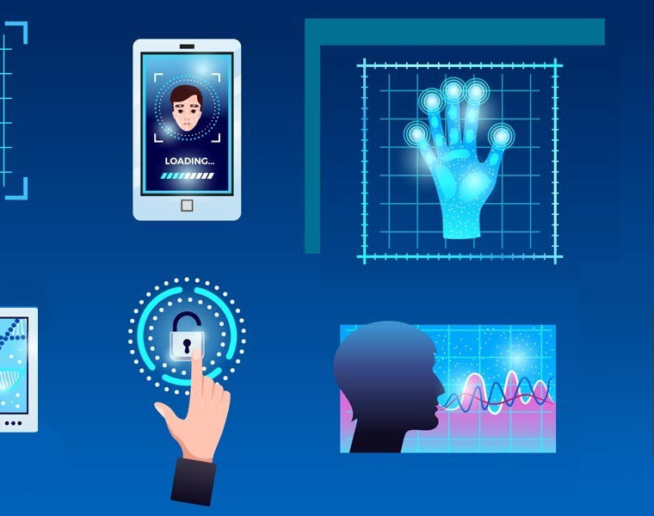
Trending technologies of AI in Data Security
Biometrics
Biometrics are biological measurements — or physical characteristics — that can be used to identify individuals. For example, fingerprint mapping, facial recognition, and retina scans etc.

Slide 16
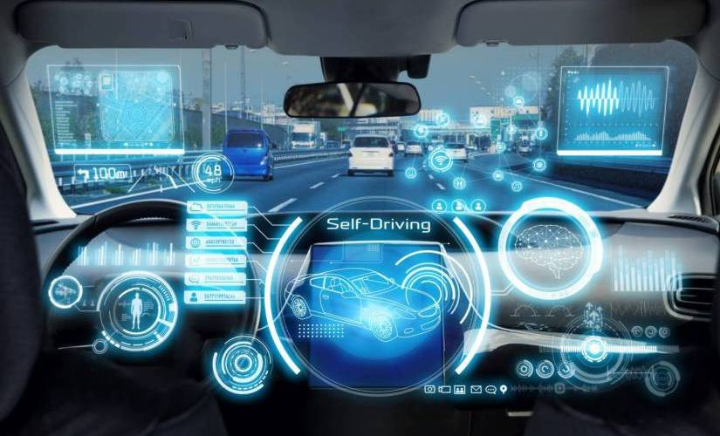
Cont’d
Rise of Automotive Hacking
Vehicles use Bluetooth and Wi-Fi technologies to communicate that also opens them to several vulnerabilities or threats from hackers.
Gaining control of the vehicle or using microphones for eavesdropping is expected to rise in 2023 with more use of automated vehicles.

Slide 17

Cont’d
Mobile is the New Target
Cybersecurity trends provide a considerable increase for mobile banking malware or attacks in 2019, making our handheld devices a potential prospect for hackers.
All our photos, financial transactions, emails, and messages possess more threats to individuals.

Slide 18
Companies developing AI based cyber security systems
1. Crowd Strike
The AI approach adopted by Crowd Strike monitors all activity on an endpoint, profiling each user’s activity and watching all of the system processes that get run on any normal day.
This establishes a baseline of regular activity. The system continues to monitor all processes and raises an alert if a user suddenly does something different or if a previously un encountered system process starts up.

Slide 19
Cont’d
Cynet
Cynet deploys AI in its network threat detection systems that examine threats and act on them automatically.
The Cynet network protection suite is written to provide accessible threat protection to organizations that do not have specialist cyber security personnel.

Slide 20
Cont’d
Fire Eye
Fire Eye is much older than the two previous companies examined in this list. It was founded in 2004 and specialized in threat research and recovery consultancy services. This is a labor- intensive field of work and didn’t make the company any money.

Slide 21
Conclusion
Artificial intelligence makes a significant contribution to the fight against modern information threats. In particular, in most cases, the introduction of AI technologies in the information security of the organization reduces the time to identify problems and respond to incidents, as well as the costs of personnel management. Operators have noted an increase in the efficiency of detecting unknown threats, as well as in the speed of analysis and detection of malicious activity on endpoints and applications.

Slide 22
Thank You

